Slide 1
An application of Polynomial Chaos
Based on the paper
A Generalized Polynomial Chaos Based Ensemble Kalman Filter
Andrew Pensoneault

Slide 2
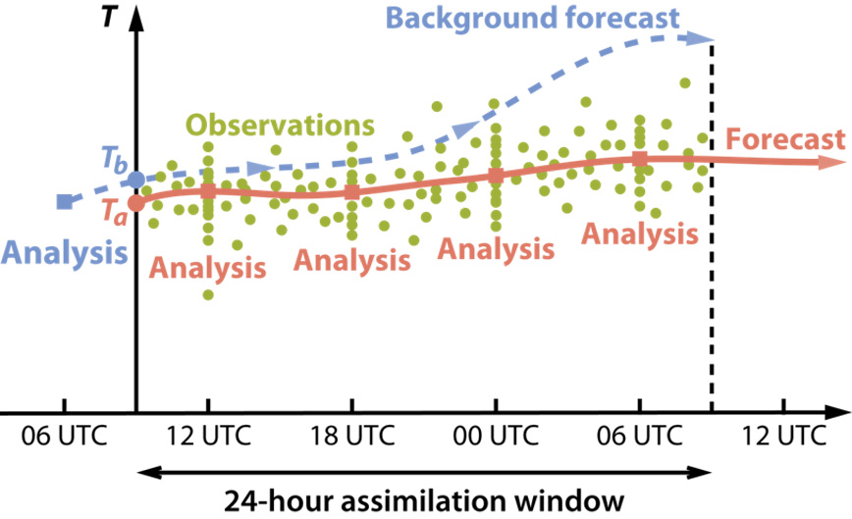

Introduction
A common problem in the modeling of uncertainty is one where there is an available model for a physical a system along with some measurements from sensors
Thus, we wish to find statistical properties of a forecast given available information which $p\left(x_{i} | y_{i},y_{i−1},…\right)$.
https://www.ecmwf.int/en/research/projects/era-clim/d-day-analyses

Slide 3
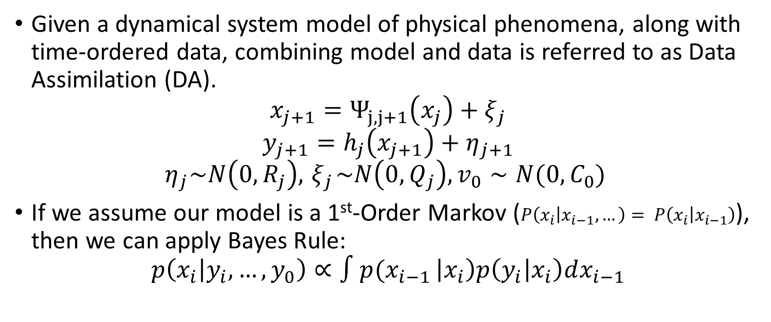
Data Assimilation
Given a dynamical system model of physical phenomena, along with time-ordered data, combining model and data is referred to as Data Assimilation (DA).
$$x_{j+1}=Ψ_{j,j+1}\left(x_{j}\right)+ξ_{j}$$
$$y_{j+1}=h_{j}\left(x_{j+1}\right)+η_{j+1}$$
$$η_{j}\sim N\left(0,R_{j}\right), { ξ}_{j}\sim N\left(0,Q_{j}\right), v_{0}∼N(0,C_{0})$$
If we assume our model is a 1st-Order Markov ($P\left(x_{i} | x_{i−1},…\right)= P\left(x_{i} | x_{i−1}\right)$), then we can apply Bayes Rule:
$$p\left(x_{i} | y_{i},…,y_{0}\right)∝∫{p(x}_{i−1 }\left|x_{i}\right)p\left(y_{i} | x_{i}\right)dx_{i−1}$$
Model:
Data:
Noise:

Slide 4
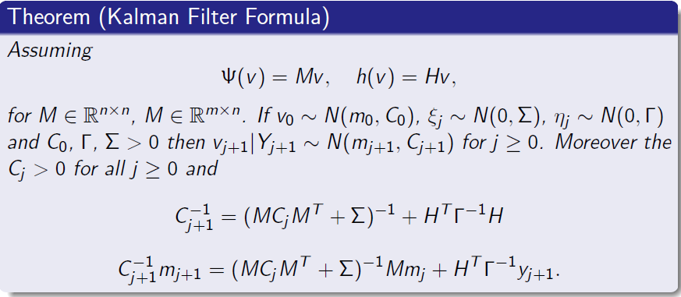
Kalman Filter

Slide 5
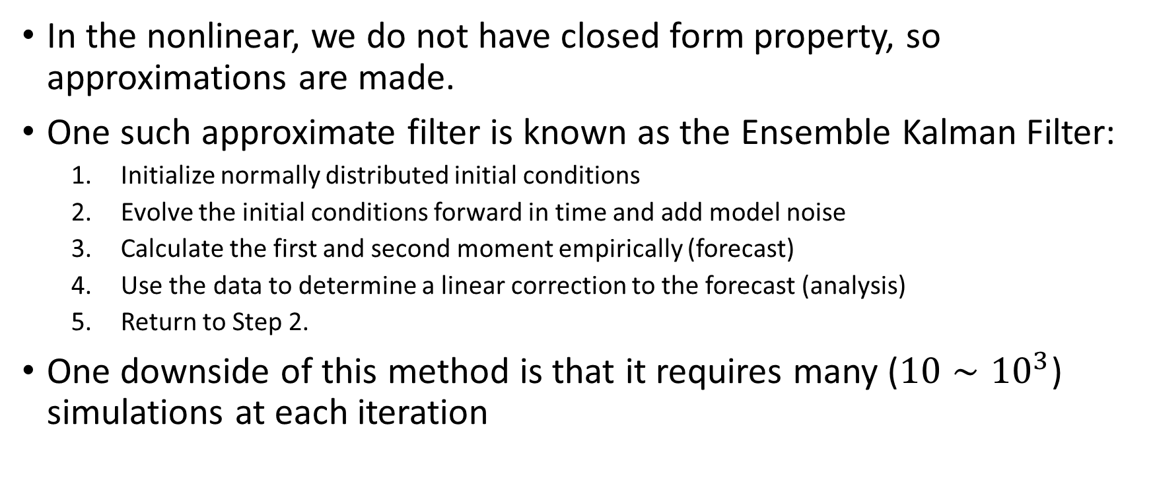
Approximate Kalman Filter
In the nonlinear, we do not have closed form property, so approximations are made.
One such approximate filter is known as the Ensemble Kalman Filter:
Initialize normally distributed initial conditions
Evolve the initial conditions forward in time and add model noise
Calculate the first and second moment empirically (forecast)
Use the data to determine a linear correction to the forecast (analysis)
Return to Step 2.
One downside of this method is that it requires many ($10∼{10}^{3}$) simulations at each iteration

Slide 6
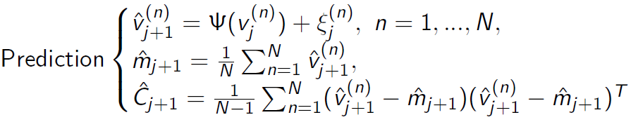
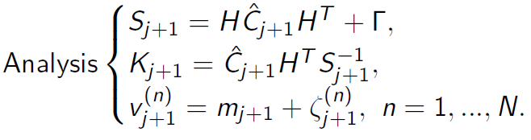






Ensemble Kalman Filter
$$m_{j+1}=\left(I−K_{j+1}H\right){\hat{m}}_{j+1}+K_{j+1}y_{j+1}$$

Slide 7
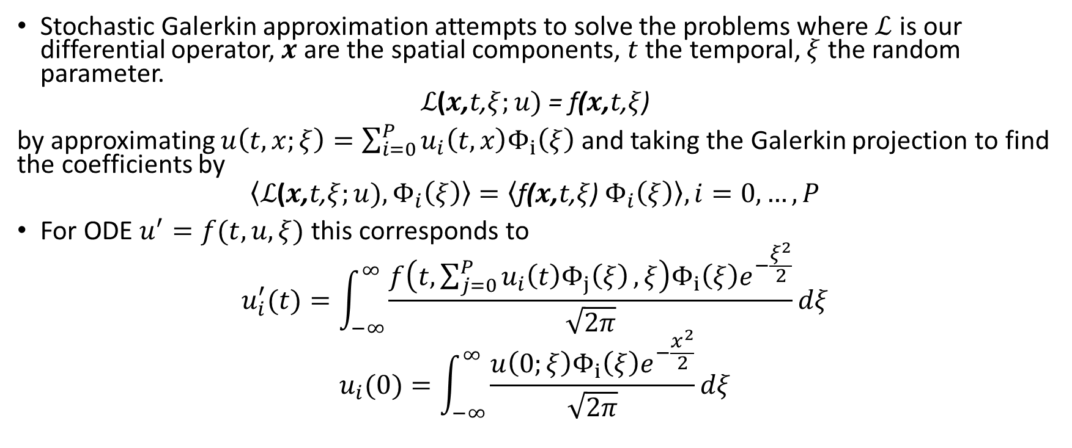
Stochastic Galerkin Method
Stochastic Galerkin approximation attempts to solve the problems where $\text{ℒ}$ is our differential operator, $x$ are the spatial components, $t$ the temporal, $ξ$ the random parameter.
$$\text{ℒ}\text{(}x\text{,}t\text{,}ξ;u)\text{ = }\text{f}\text{(}x\text{,}t\text{,}ξ\text{)}$$
by approximating $u\left(t,x;ξ\right)=\sum_{i=0}^{P}{u_{i}\left(t,x\right)Φ_{i}\left(ξ\right)}$ and taking the Galerkin projection to find the coefficients by
$$\left\langle \text{ℒ}\text{(}x\text{,}t\text{,}ξ;u),Φ_{i}\left(ξ\right)\right\rangle =\left\langle \text{f}\text{(}x\text{,}t\text{,}ξ\text{)} Φ_{i}\left(ξ\right)\right\rangle , i=0,…,P$$
For ODE $u^{′}=f(t,u,ξ)$ this corresponds to
$$u_{i}^{′}(t)=\int_{−∞}^{∞}{\frac{f\left(t,\sum_{j=0}^{P}{u_{i}\left(t\right)Φ_{j}\left(ξ\right)},ξ\right)Φ_{i}\left(ξ\right)e^{−\frac{ξ^{2}}{2}}}{\sqrt{2π}}}dξ$$
$$u_{i}(0)=\int_{−∞}^{∞}{\frac{u\left(0;ξ\right)Φ_{i}\left(ξ\right)e^{−\frac{x^{2}}{2}}}{\sqrt{2π}}}dξ$$

Slide 8
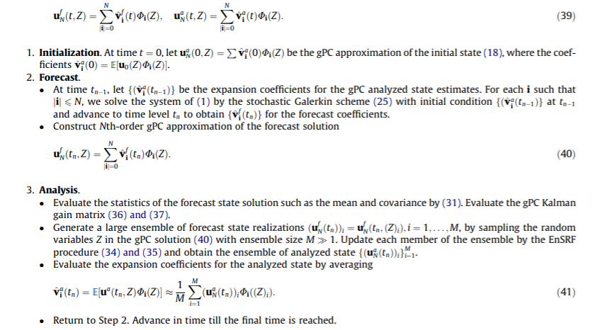

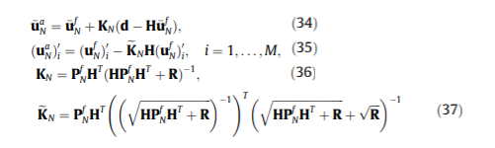
Stochastic Galerkin - EnKF

Slide 9
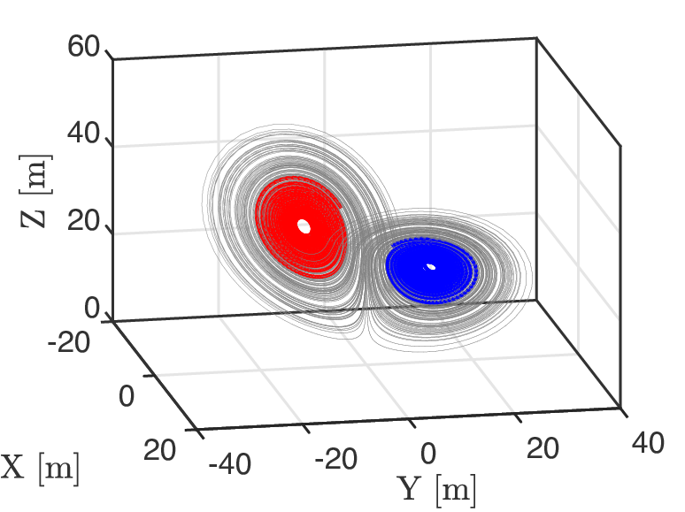
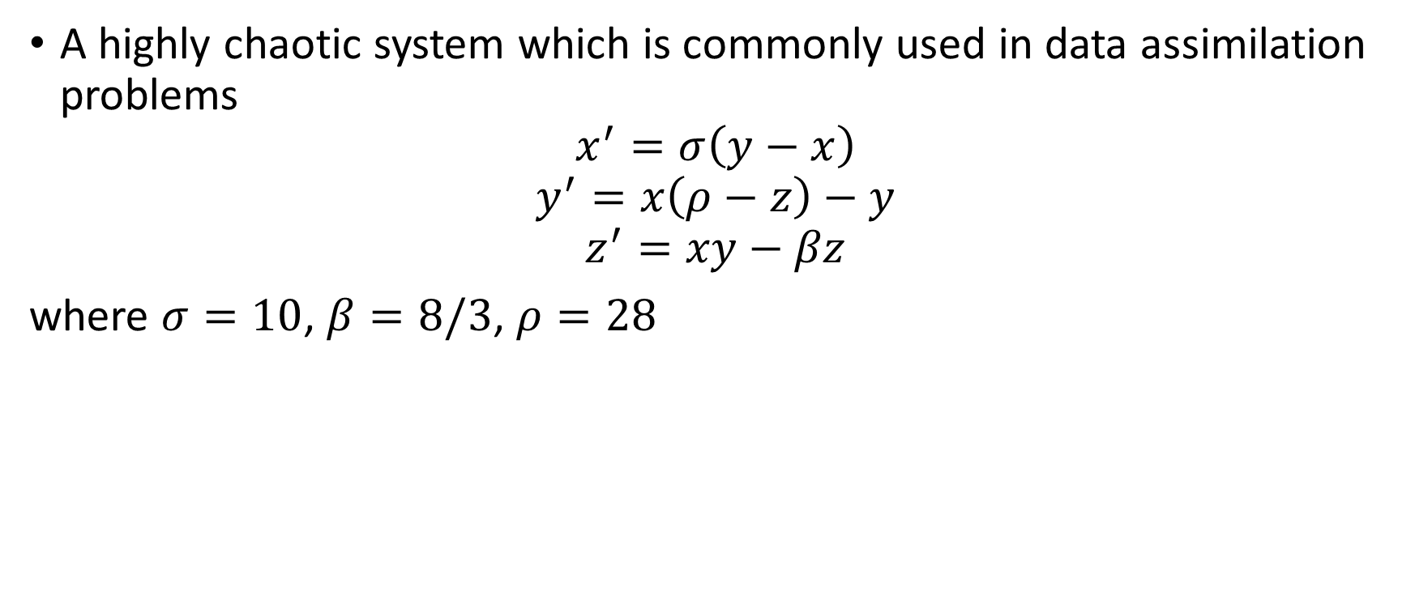
Lorenz 63
A highly chaotic system which is commonly used in data assimilation problems
$$x^{′}=σ\left(y−x\right)$$
$$y^{′}=x\left(ρ−z\right)−y$$
$$z^{′}=xy−βz$$
where $σ=10$, $β=8/3$, $ρ=28$

Slide 10
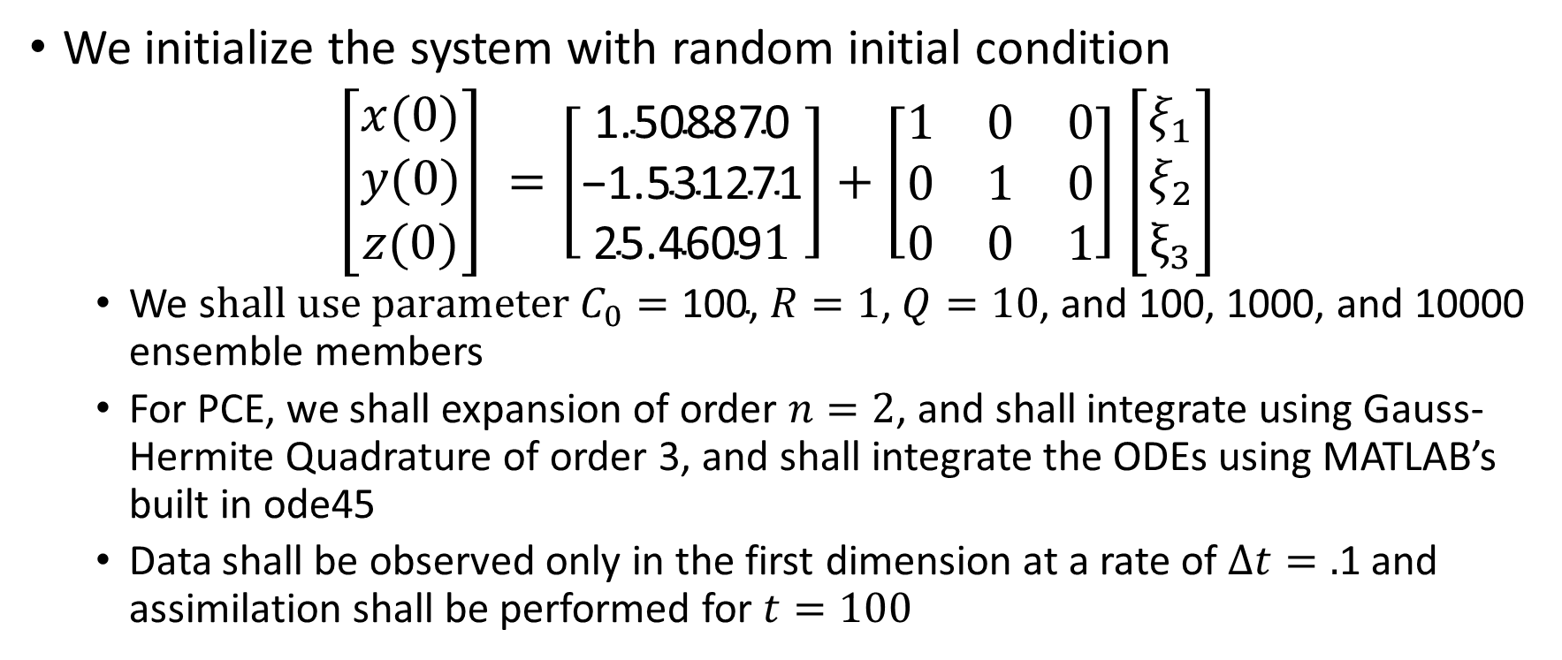
Problem setup
We initialize the system with random initial condition
$\left[\begin{matrix}x(0) \\ y(0) \\ z(0)\end{matrix}\right] =\left[\begin{matrix}\text{1.508870} \\ \text{−1.531271} \\ \text{25.4609}1\end{matrix}\right]+\left[\begin{matrix}1 & 0 & 0 \\ 0 & 1 & 0 \\ 0 & 0 & 1\end{matrix}\right]$ $\left[\begin{matrix}ξ_{1} \\ ξ_{2} \\ ξ_{3}\end{matrix}\right]$
We s$hall use parameter C_{0}=\text{100}\text{,}$ $R=1$, $Q=10$, and 100, 1000, and 10000 ensemble members
For PCE, we shall expansion of order $n=2$, and shall integrate using Gauss-Hermite Quadrature of order 3, and shall integrate the ODEs using MATLAB’s built in ode45
Data shall be observed only in the first dimension at a rate of $Δt=.$1 and assimilation shall be performed for $t=100$

Slide 11
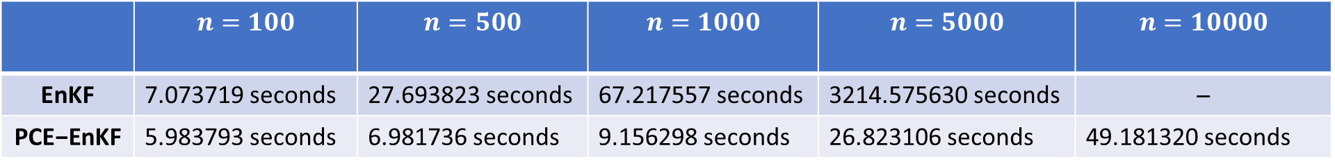
Clock time for 100 assimilation cycles
 | $$n=100$$ | $$n=500$$ | $$n=1000$$ | $$n=5000$$ | $$n=10000$$
EnKF | 7.073719 seconds | 27.693823 seconds | 67.217557 seconds | 3214.575630 seconds | ̶
$$\text{PCE}\text{−}\text{EnKF}$$ | 5.983793 seconds | 6.981736 seconds | 9.156298 seconds | 26.823106 seconds | 49.181320 seconds

Slide 12
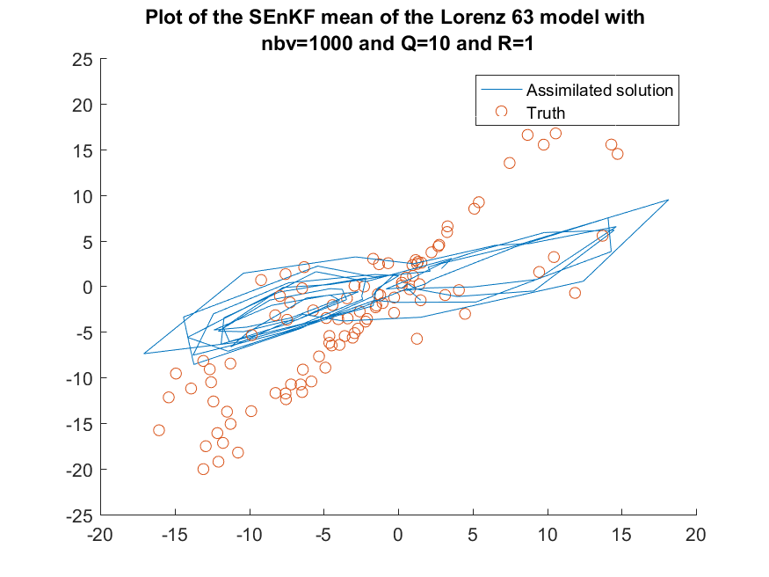
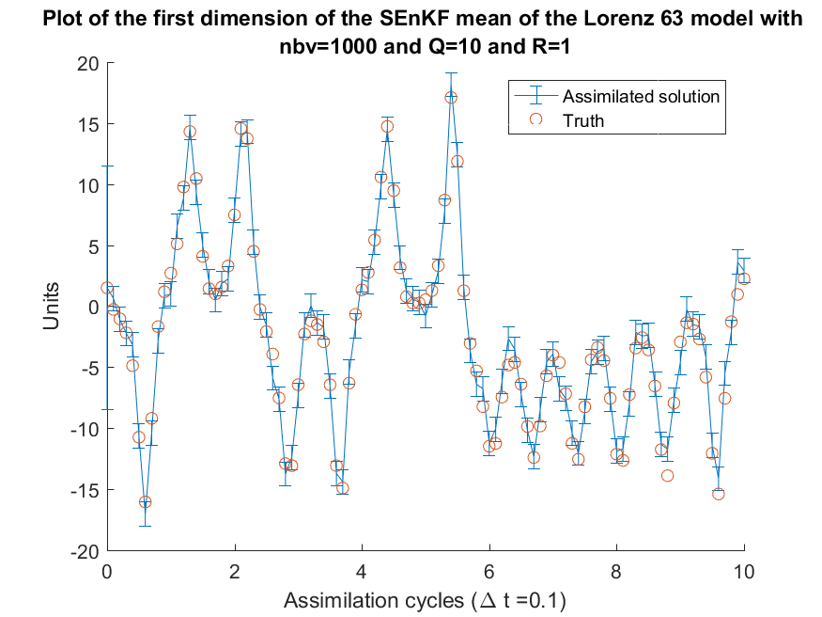
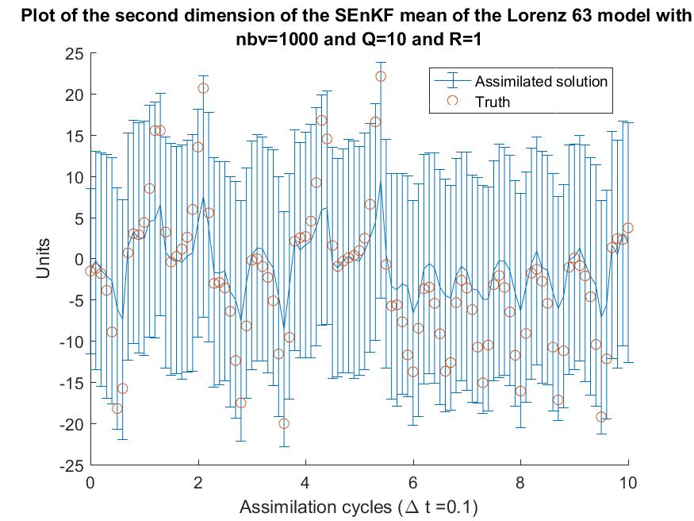
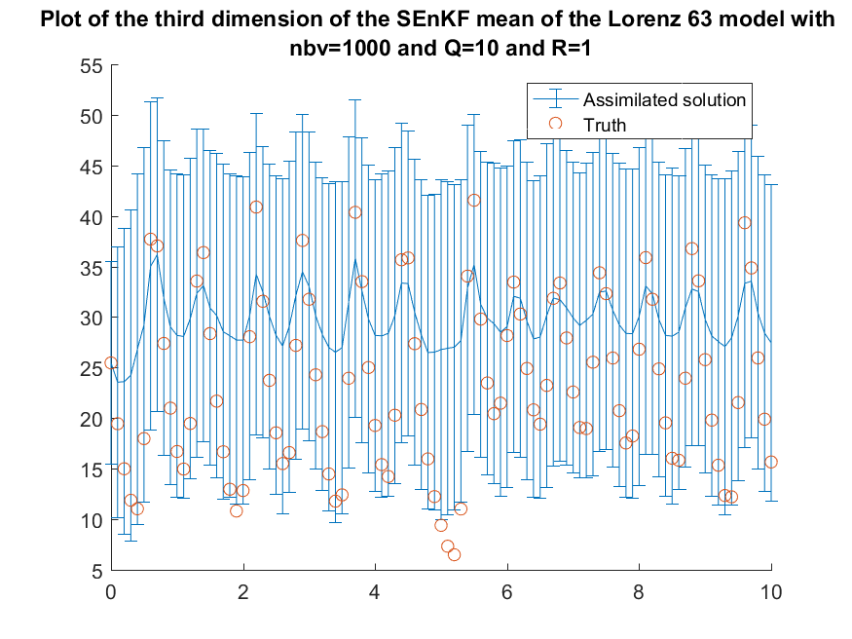
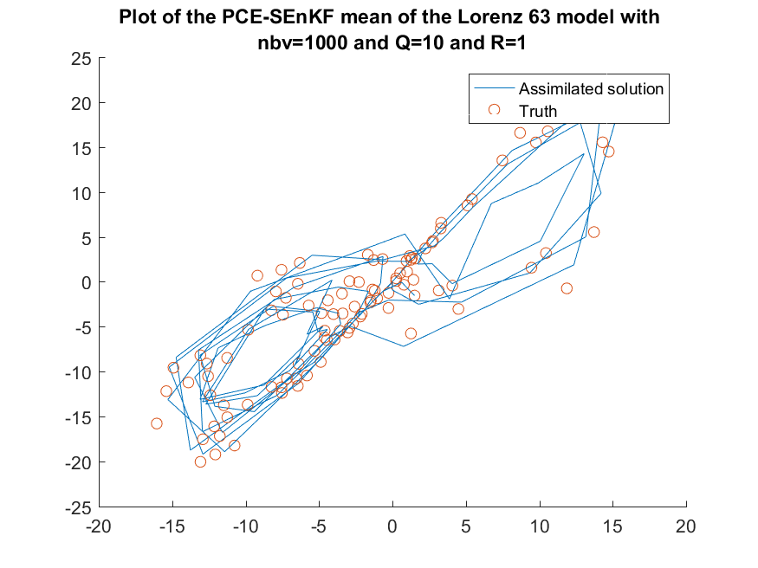
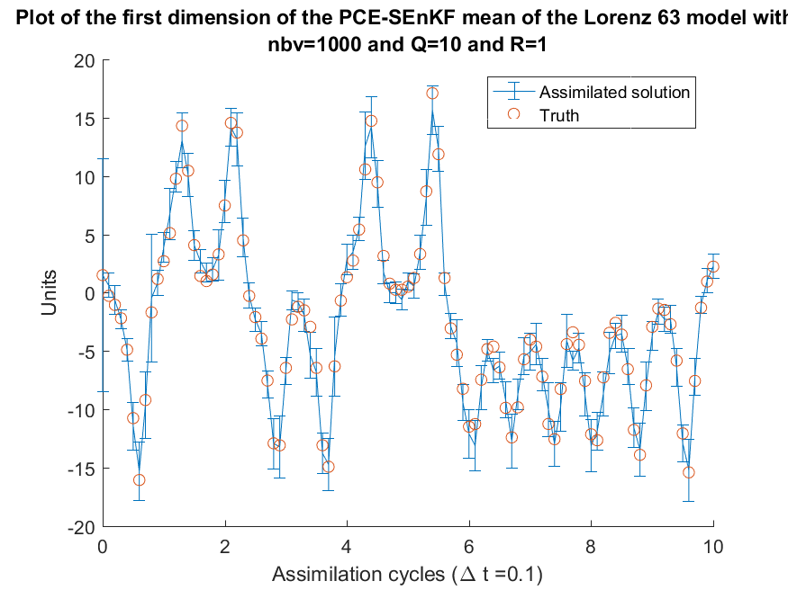
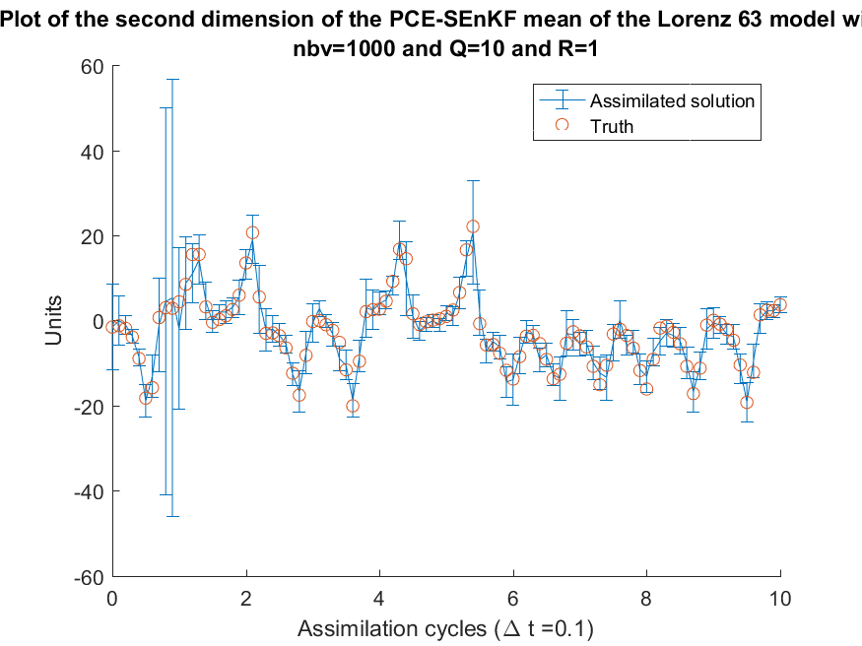
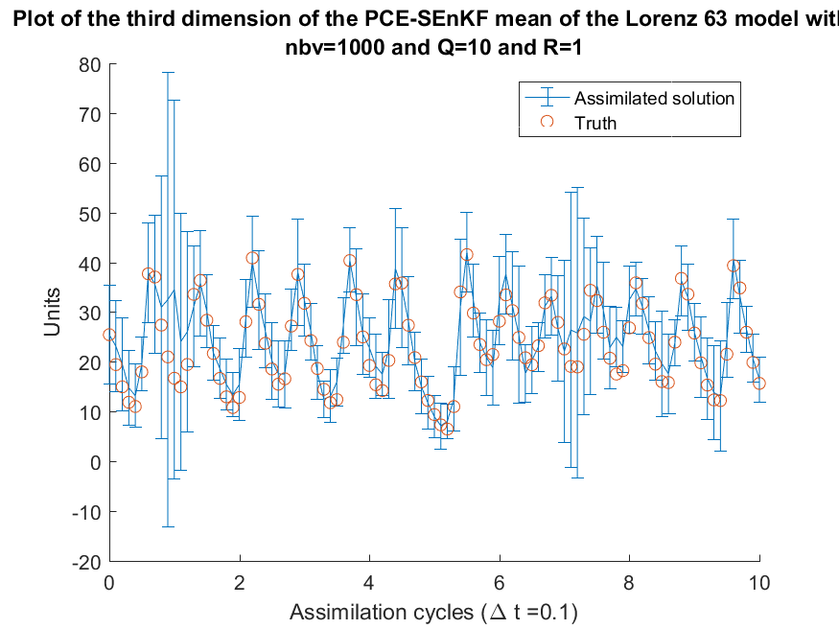
Plots of results for 100 ensemble members

Slide 13
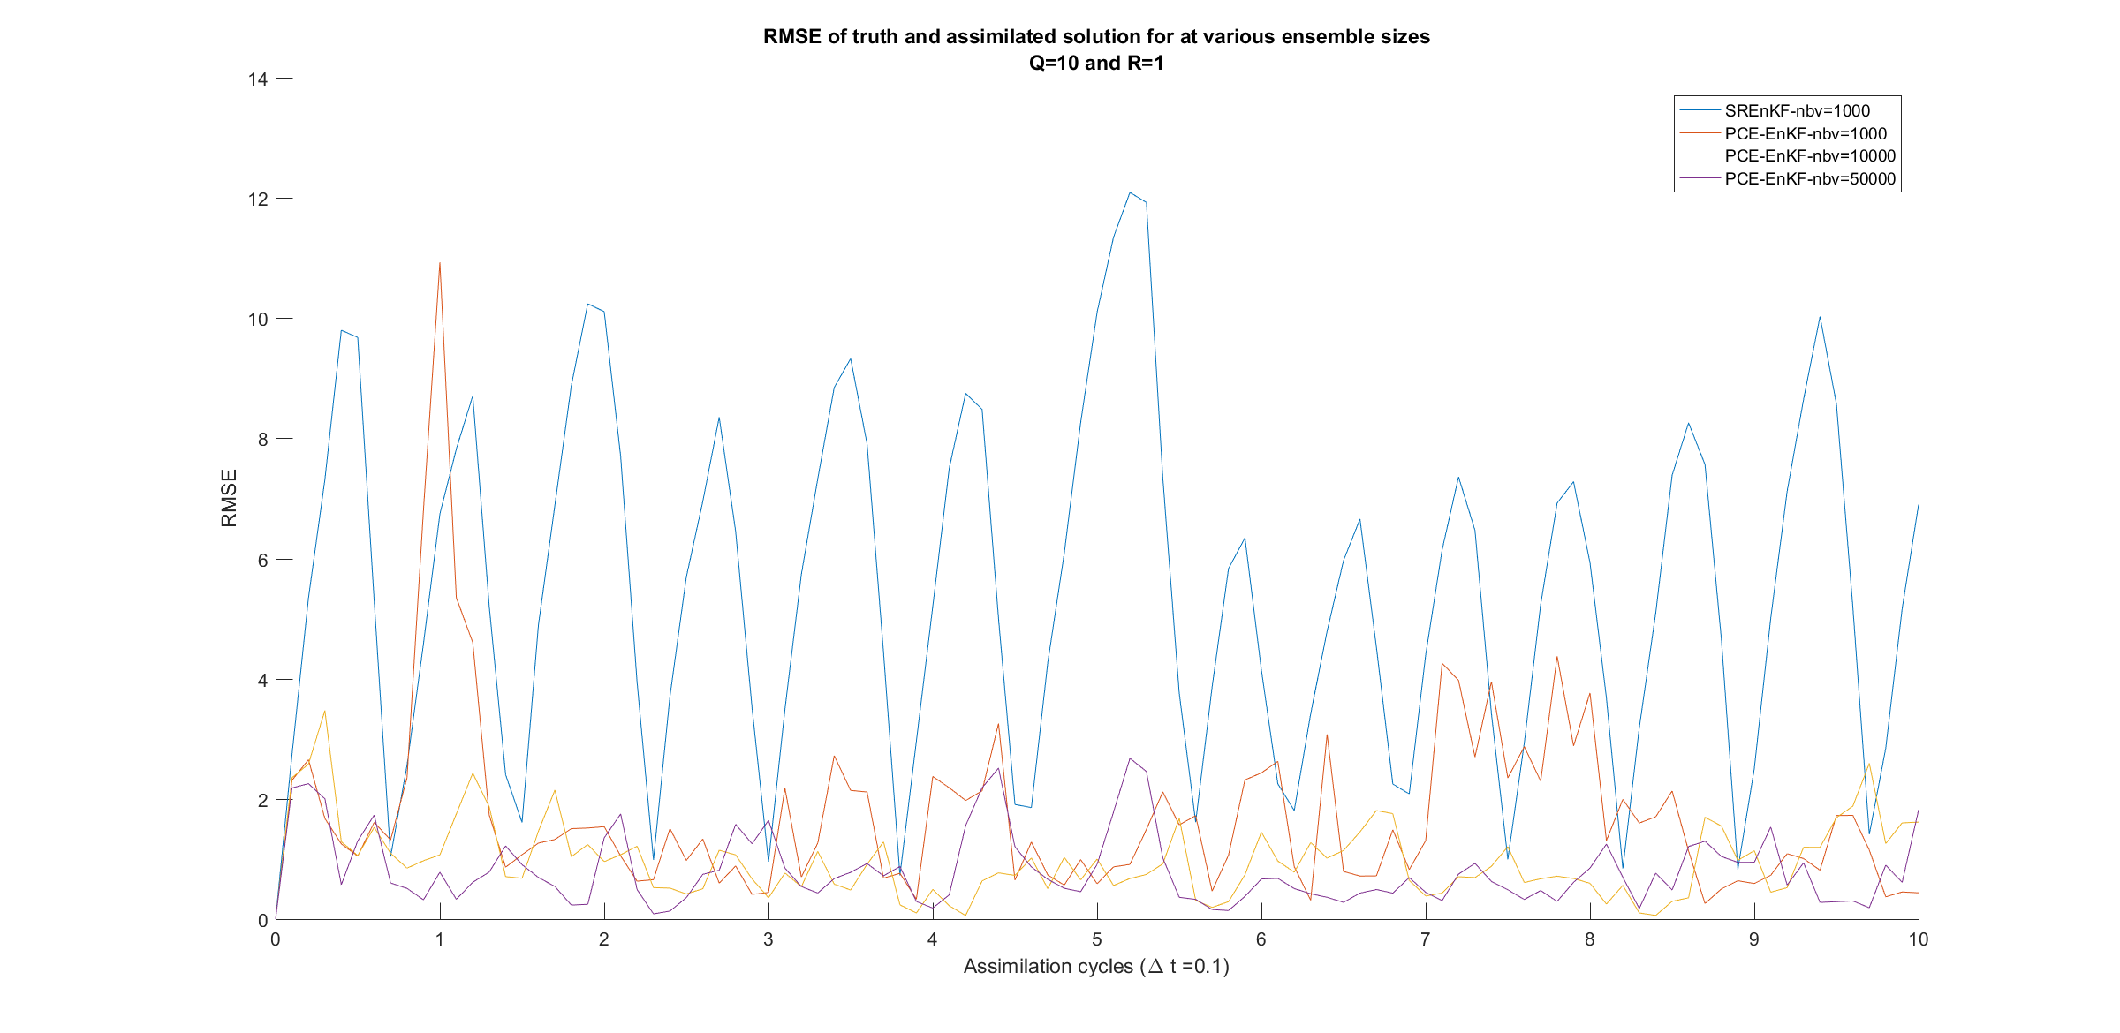
RMSE for ensemble size 1000

Slide 14
Github
The Code Repository is available at the following link:
https://github.com/Andrewpensoneault/Lorenz_63_Stochastic_Galerkin_EnKF

